Slide 1
How We Learn with Immersive Virtual Technologies
https://hubs.mozilla.com/link/yPB4pk4
Click to enter my virtual room
Yang Liu
IDE830-Spring 2023

Slide 2

Yang Liu
Broadcasting and TV
Screen Media Production for cultural heritage
Instructional Designer and researcher
Virtual Learning Environment Design, Development Implementation and Evalution
Theory-driven or/and Phenomena-driven Learning Experience Design

Slide 3
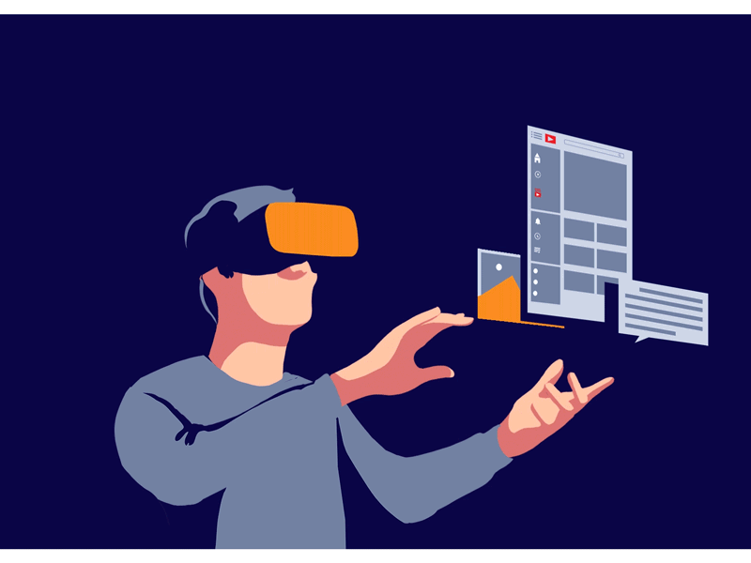
My Research Goal:
Study how instructional strategies/methods enable IVR in the sense that an instructional method/strategy specifically facilitates the affordances of, or limits the shortcomings of, learning in IVR.
How do we learn in immersive VR environment?
How can we make the immersive VR-based learning not just engaging or enjoyful but also effective and meaningful?

Slide 4

Community of Practice
IVR vs. Non-IVR
My assumption is that
The instructional method used in an IVR-based lesson could be specifically effective if it facilitates the unique affordances of the medium.

Slide 5
Immersion, Interaction, Fidelity, Accessibility
What theories can help us to understand why IVR’ unique features can be detrimental or beneficial to learning?
What theoretical frameworks can be used to design immersive learning interventions that can facilitate learning?
Challenges:
Accessibility (Access to devices)
Instructional design elements in IVR
IVR Content Creation

Slide 6

Where do I want to go from here?
understand and explain human cognition and behavior,
identify the causes of performance gaps,
critically evaluate the strengths and weaknesses of each technology,
develop appropriate instructional strategies based on learning needs and instrutional goals
evaluate the use of technology in teaching and learning
Notes:
While technology is constantly evolving and advancing, it is not the key factor that contributes to learning and progress. Rather, human cognition and behavior play a crucial role in the process. As an instructional designer, I believe it is essential to maintain an objective and rational perspective when evaluating the use of technology in the classroom. It is crucial to assess emerging technologies based on their potential to address learners' needs and facilitate effective teaching practices. By doing so, I always kept in mind to focus on the essence of performance/learning phenomenon, always look at the underlying issues and identify the root causes of performance difficulties or gaps before conducting any instructional design intervention. I believe it is necessary to identify the strengths and weaknesses of each technology, determine how they align with the instructional goals, and develop appropriate instructional strategies that may facilitate learning.

Slide 7
Thank you! 3
Yang Liu
yliu424@syr.edu

